Slide 1
Colgate's Digital Shelf Performance Analysis
Analyzing Changes in Product Content Performance
Arvin Dodangeh
Date : 02/03/2024

Slide 2
Introduction :
Purpose:
The aim is to explore shifts in product content performance for Colgate goods on the digital shelf.
Importance:
The digital shelf plays a pivotal role for Colgate, shaping customer interactions, brand perception, and ultimately, sales.
Objectives:
Compare Retailer 2 and Retailer 3 performance, focusing on product content score and other vital metrics.
Examine the evolution of product content performance between Q1 2023 and Q4 2022.
Identify areas for improvement and opportunities to enhance Colgate's digital shelf presence.

Slide 3
Data Overview :
Data Sources:
The analysis was conducted using data from Google Sheets and processed in Python using Jupyter Notebook.
Key Metrics and Columns Analyzed:
The key metrics and columns analyzed include:
Retailer information (Retailer 2 and Retailer 3)
EAN (European Article Number), UPC (Universal Product Code), RPC (Retail Price Channel), Product Model Number, Product Title
Performance metrics: Total Score, Total Score (Change), Product Content Score, Product Content Score (Change), Assortment & Availability Score, Assortment & Availability Score (Change), Ratings & Reviews Score, Ratings & Reviews Score (Change), Placement Score, Placement Score (Change)
Category and Subcategory information
Data Cleaning and Preprocessing:
Several preprocessing steps were undertaken, including:
Dropping duplicate rows and handling missing values to ensure data integrity.
Merging datasets from different time frames (Q1 2023 and Q4 2022) and retailers (Retailer 2 and Retailer 3) for comparative analysis.
Utilizing KNN imputer to fill missing values in content score and content score change columns.

Slide 4
Methodology:
Analysis Approach:
To get a clear picture, we focused on a specific list of EANs provided in the task. This helped us maintain consistency and relevance throughout our analysis.
Data Grouping and Comparison:
We took the data from both Q1 and Q4 for Retailer 2 and Retailer 3 and grouped it by categories and subcategories. This allowed us to compare apples to apples and oranges to oranges, so to speak.
Metric Comparison:
For comparing different metrics, we opted for the mean values of these metrics for Q1 and Q4 for each retailer. This approach provided us with a consolidated view of the performance metrics over the specified time frames.
Statistical Techniques and Algorithms:
To handle missing data, the KNN (K-Nearest Neighbors) imputation algorithm was employed. This technique helped in filling missing values in content score and content score change columns, ensuring a more comprehensive analysis.

Slide 5
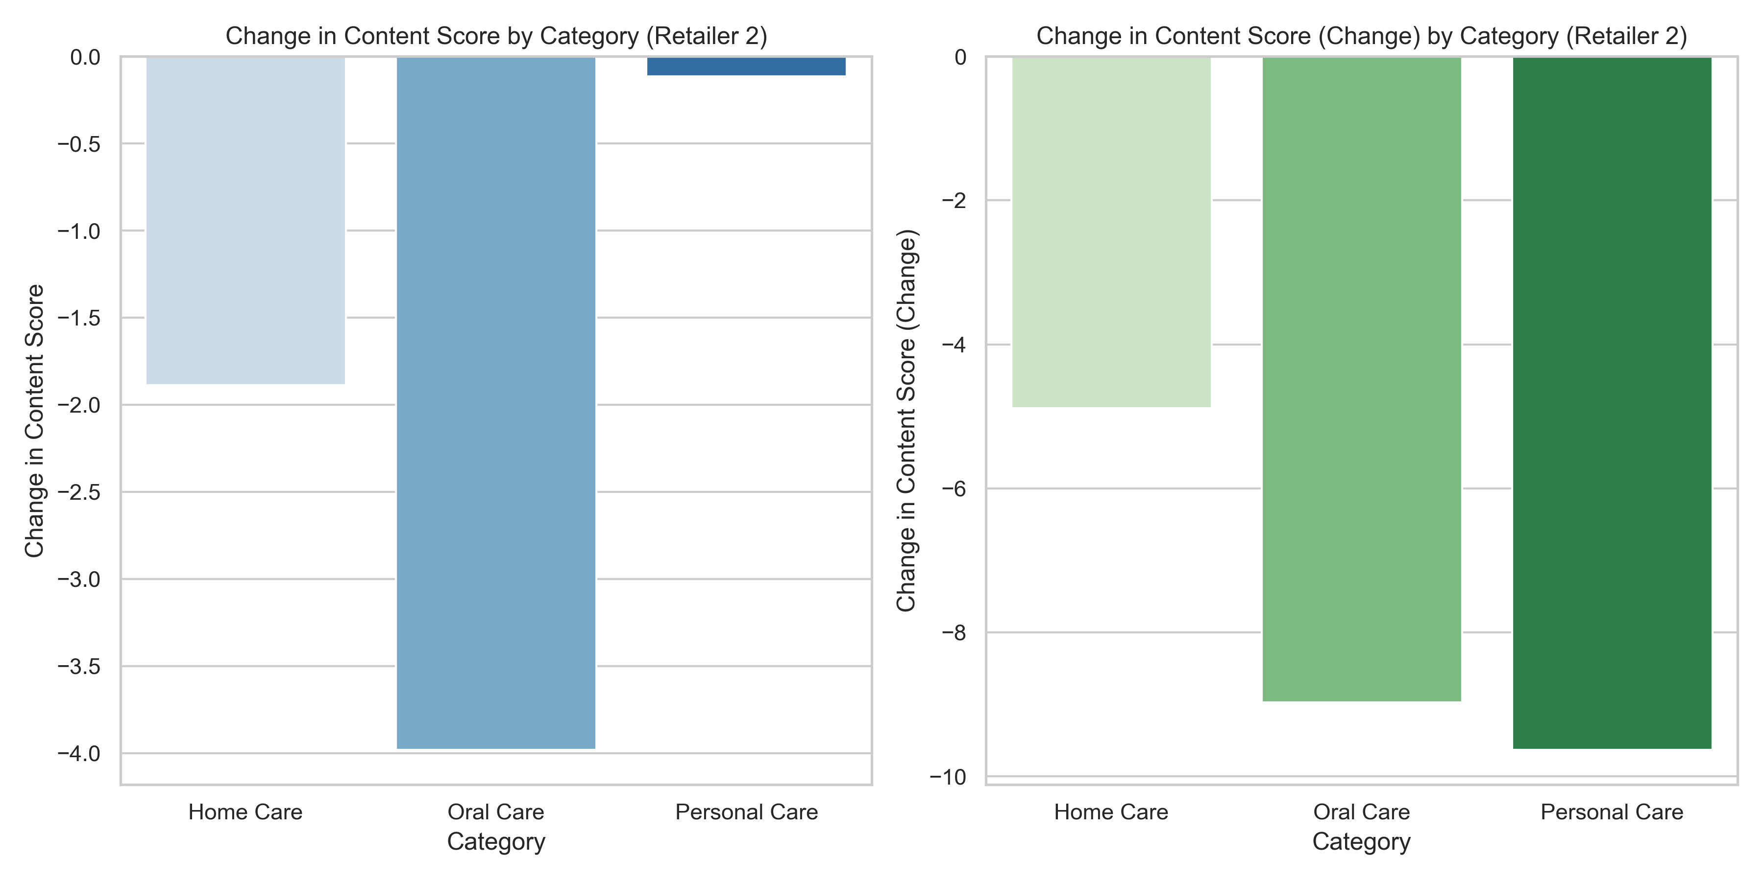
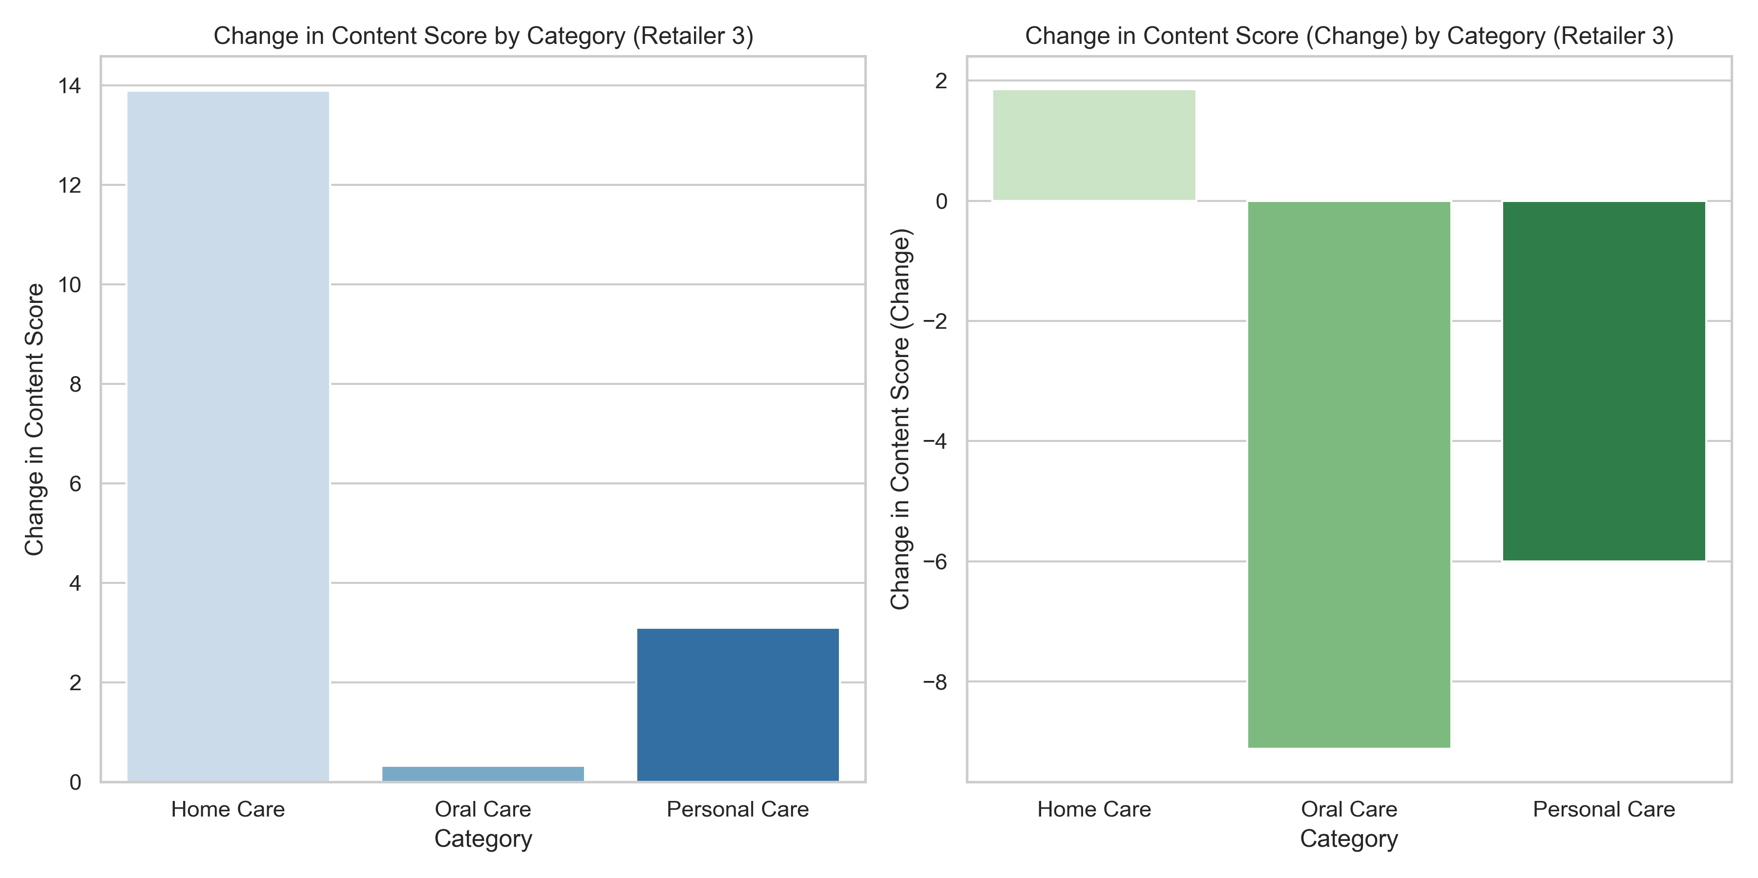
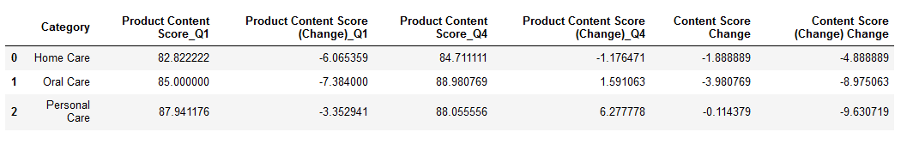
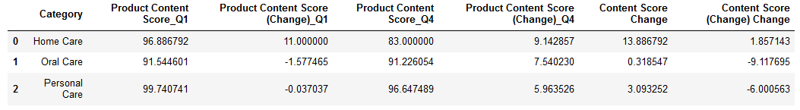
Retailer Comparaison between (Q1,Q4) :
Retailer 2's content scores consistently decreased across all categories in Q1 and Q4
The magnitude of these negative changes varied, but none of Retailer 2's categories showed positive score improvements. These consistent decreases suggest that Retailer 2's content
strategy in Q1 and Q4 might not have been as effective as it could have been.
In contrast, Retailer 3 experienced positive content score changes in all categories for both Q1 and Q4.
While there were a few negative changes in Retailer 3, the overall trend was positive, indicating a generally more effective content strategy compared to Retailer 2 in Q1 and Q4.

Slide 6
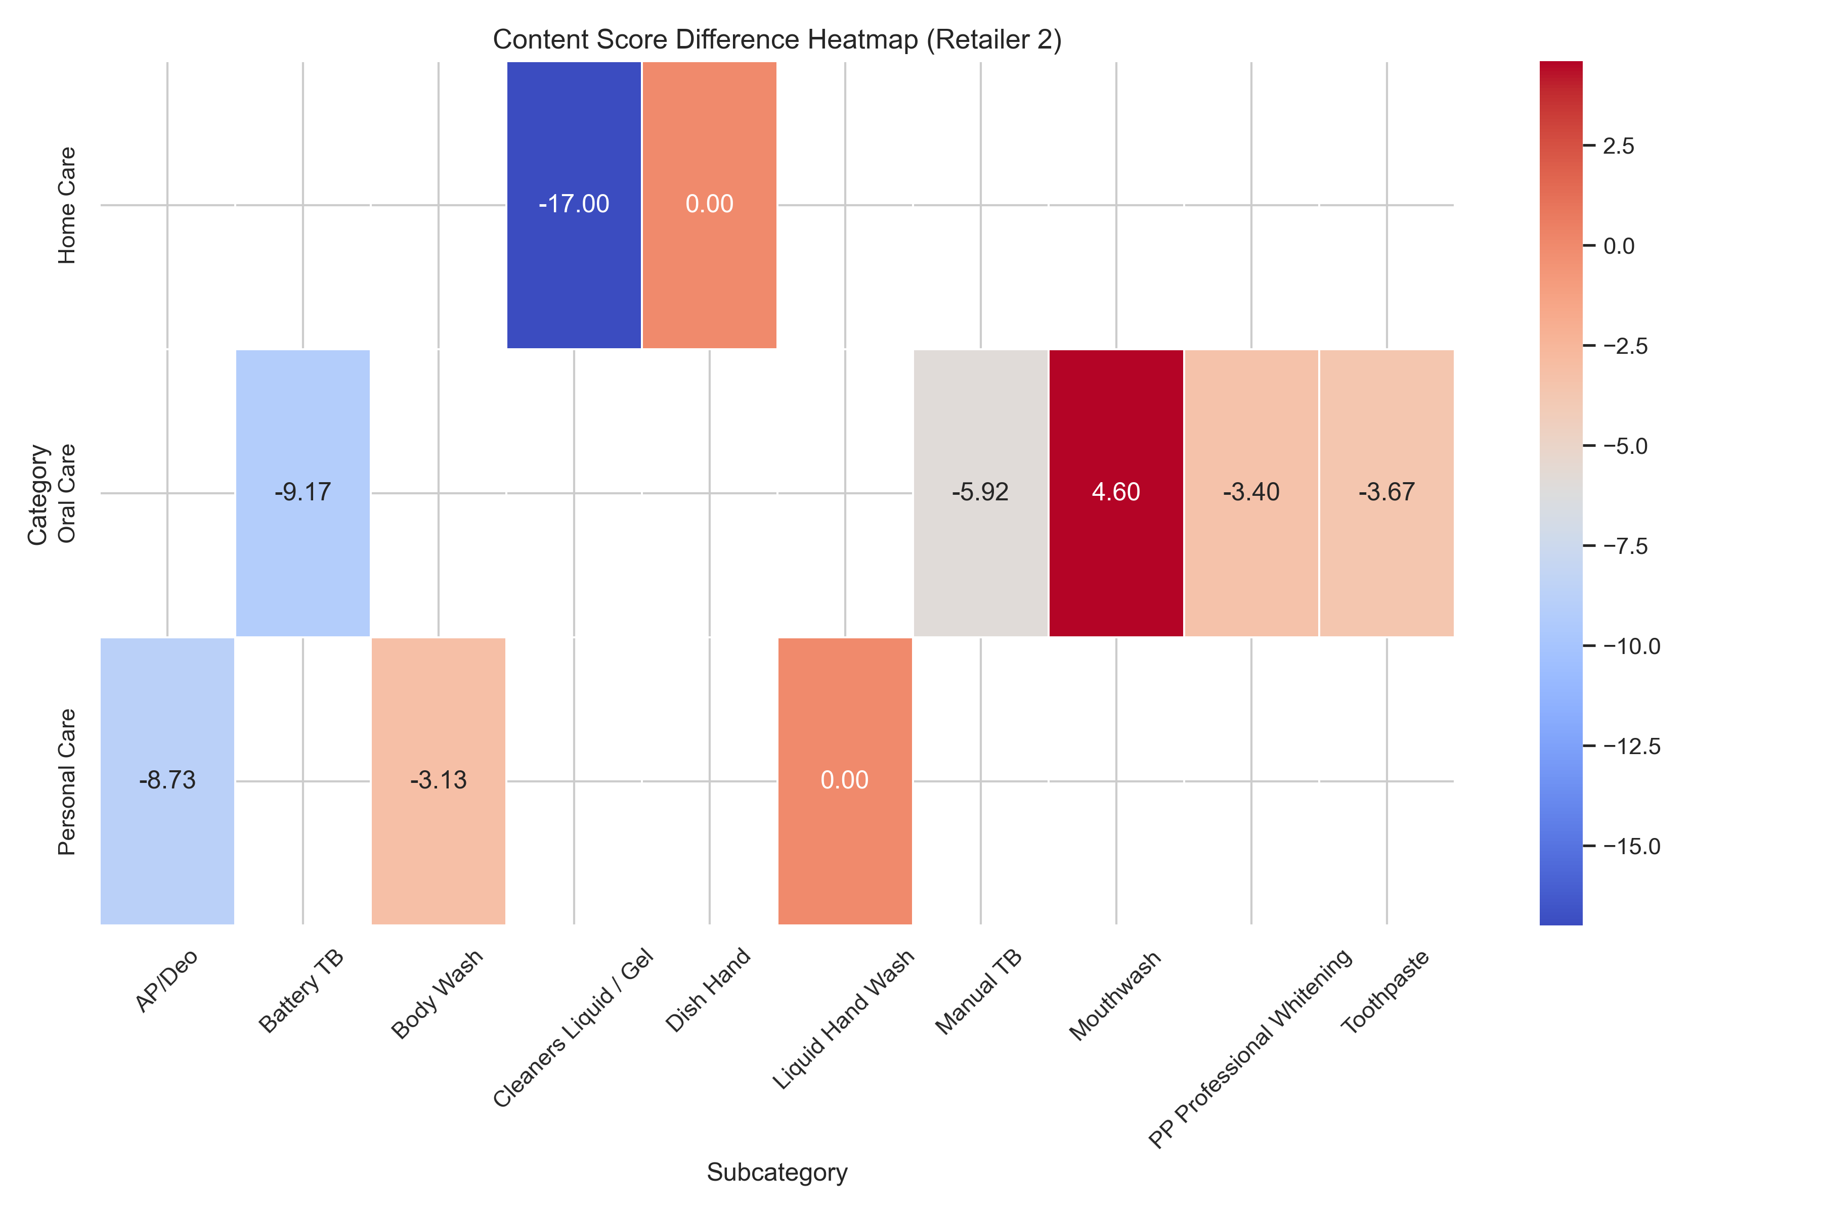
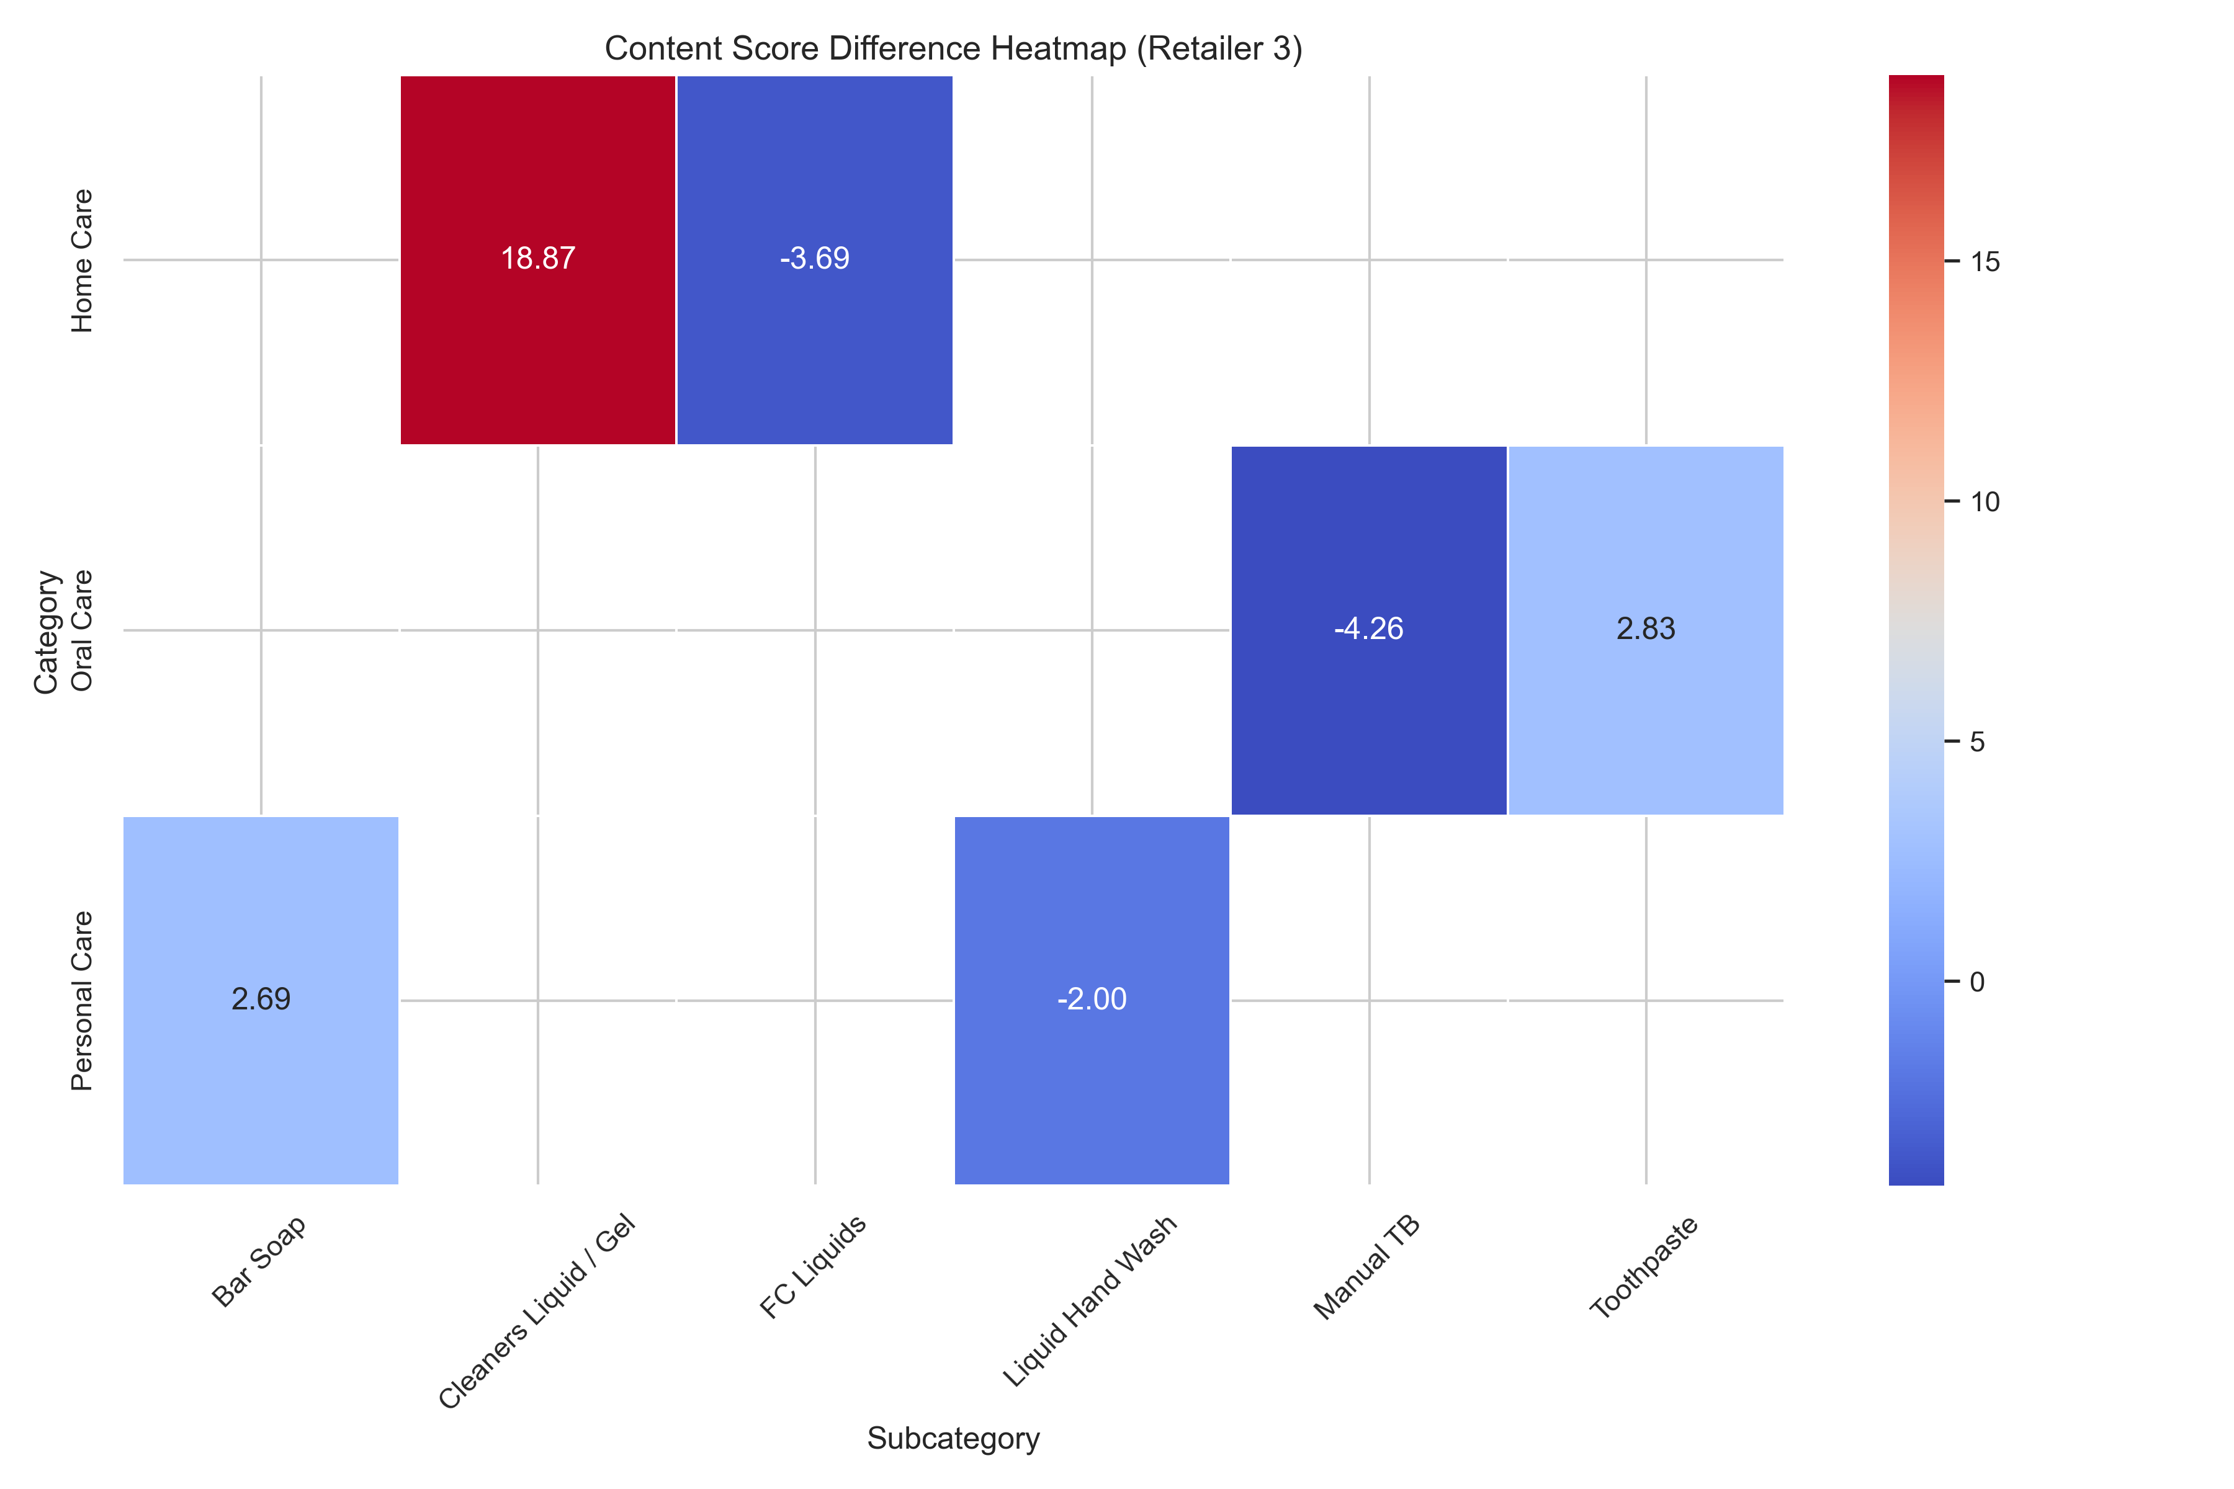
Subcategory Analysis of content score difference :
Retailer 2's content score changes reveal a predominantly negative trend across most subcategories in Q1 and Q4
While Mouthwash saw a positive change, the Oral Care category overall experienced the steepest decline in content score, highlighting areas for improvement.
Subcategory (Liquid/Gel) stands out with the most significant negative change, suggesting potential optimization opportunities.
While all Retailer 3 categories show positive content score changes, some subcategories within each category exhibit negative trends, indicating room for improvement.
Home Care emerges as the top performer with the most positive content score change in Retailer 3
It's important to note that subcategories within each category can have varying performance levels. Even with an overall positive category trend, subcategories with lower scores and higher representation can contribute to a negative difference at the subcategory level.

Slide 7
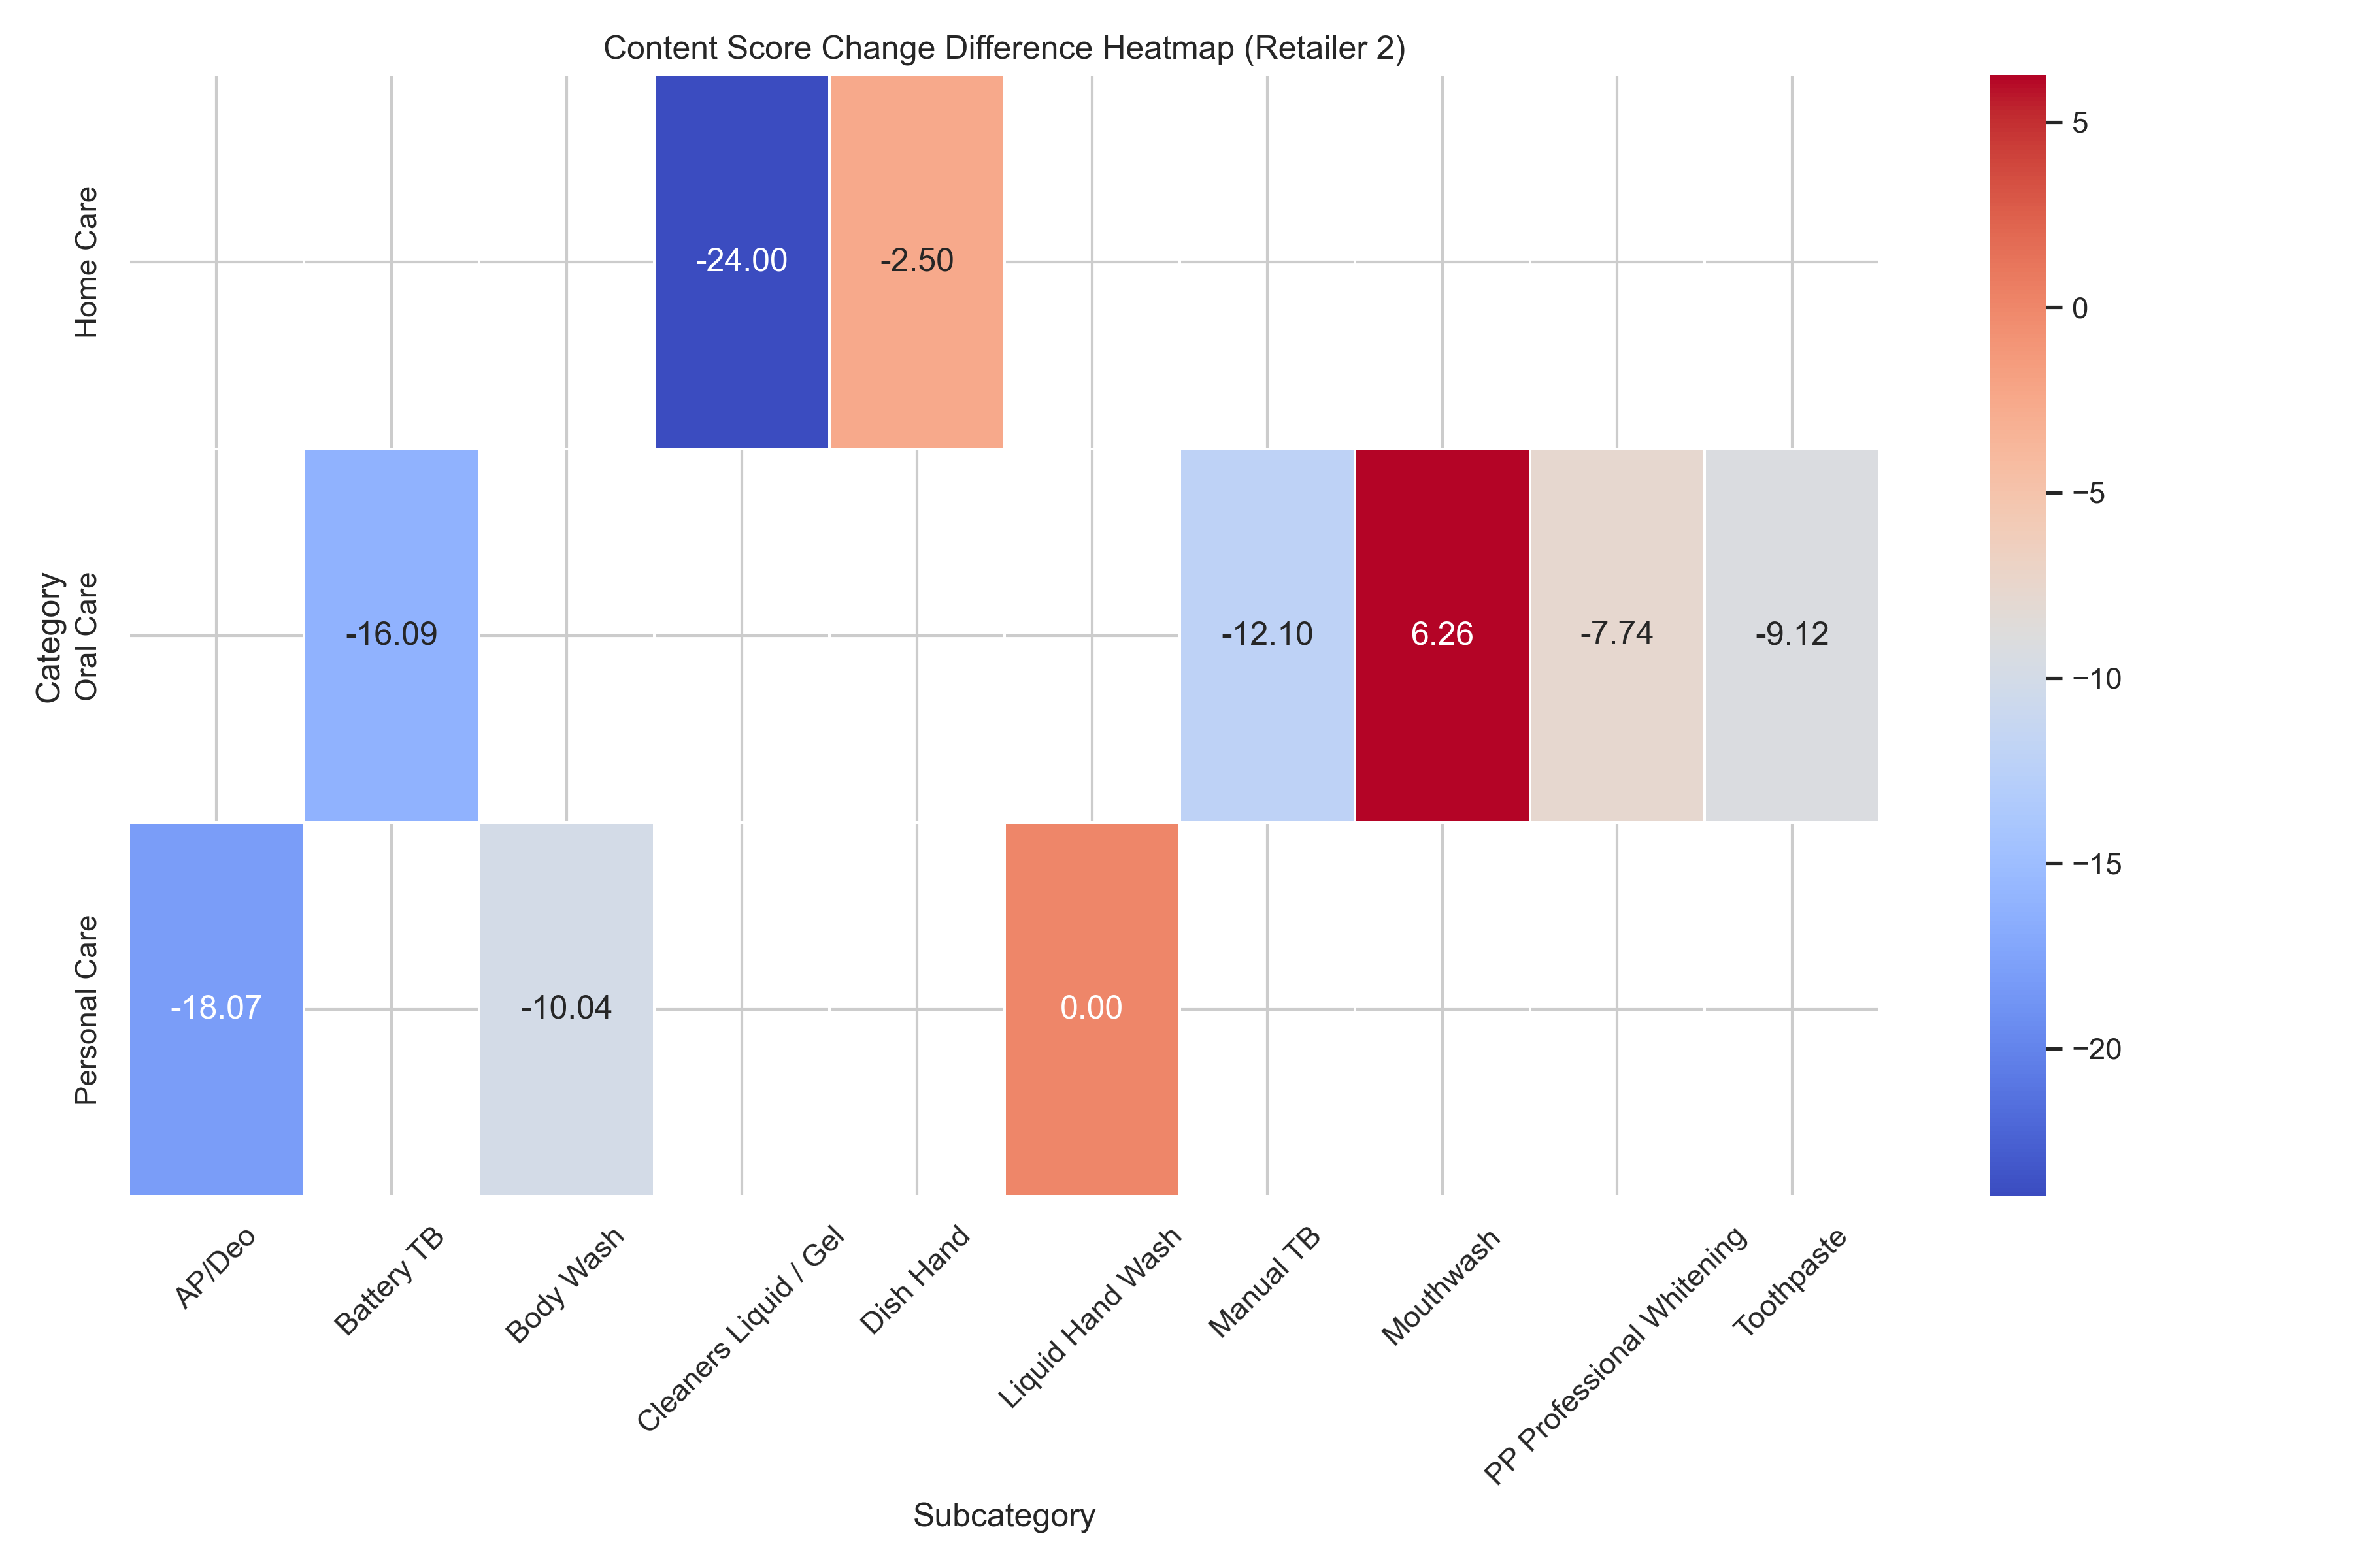
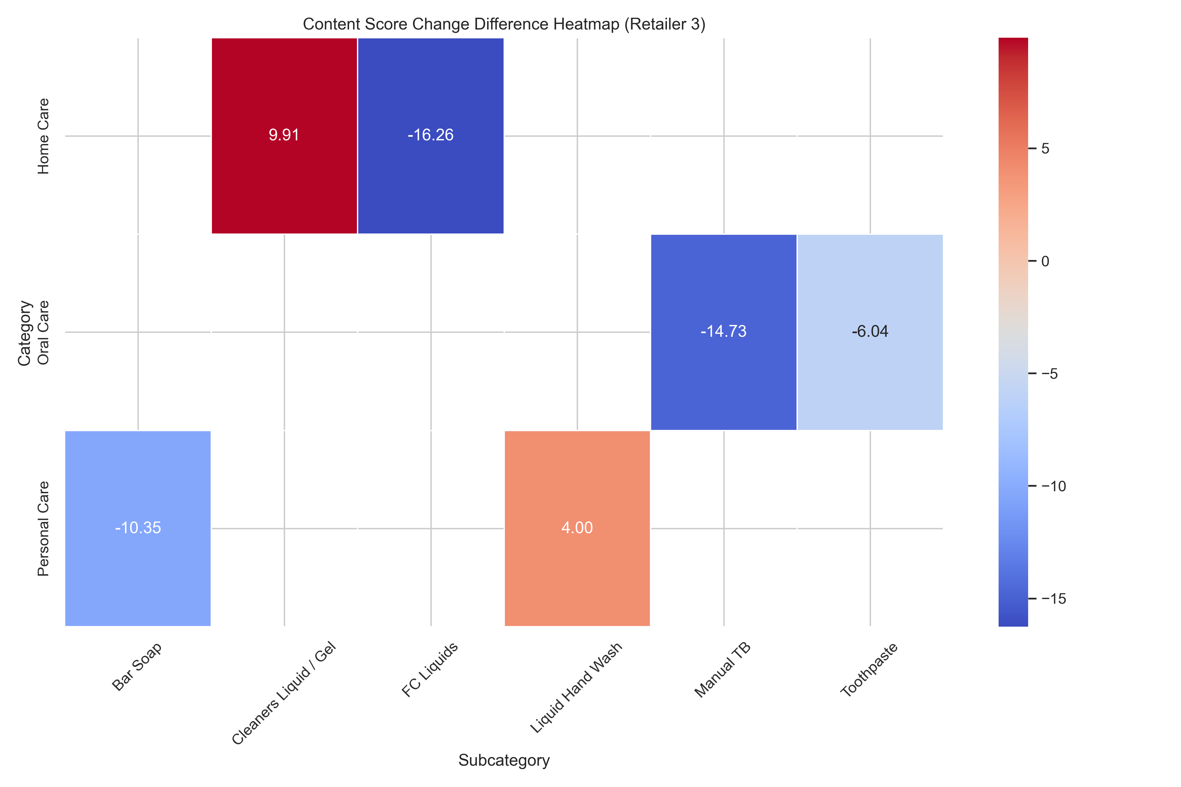
Subcategory Analysis of content score(change) difference :
Retailer 2's content score changes reveal a predominantly negative trend across most subcategories, particularly for Cleaners (Liquid/Gel) and Antiperspirant/Deodorant, which experienced the largest declines in Q1 and Q4
While Cleaners (Liquid/Gel) saw the sharpest negative change, this doesn't necessarily contradict a positive content strategy. It's crucial to analyze category and subcategory trends holistically to understand the bigger picture.
Among Retailer 3's subcategories, Cleaners (Liquid/Gel) stands out with the most positive change in content score, indicating improvement efforts in this area.
Remember that subcategory performance can differ within categories. While Home Care showed a positive overall trend in the bar chart, the heatmap reveals that the Cleaners (Liquid/Gel) subcategory within Home Care had a positive change, contributing to the overall positive category trend. This highlights the importance of analyzing both category and subcategory levels for nuanced insights.

Slide 8
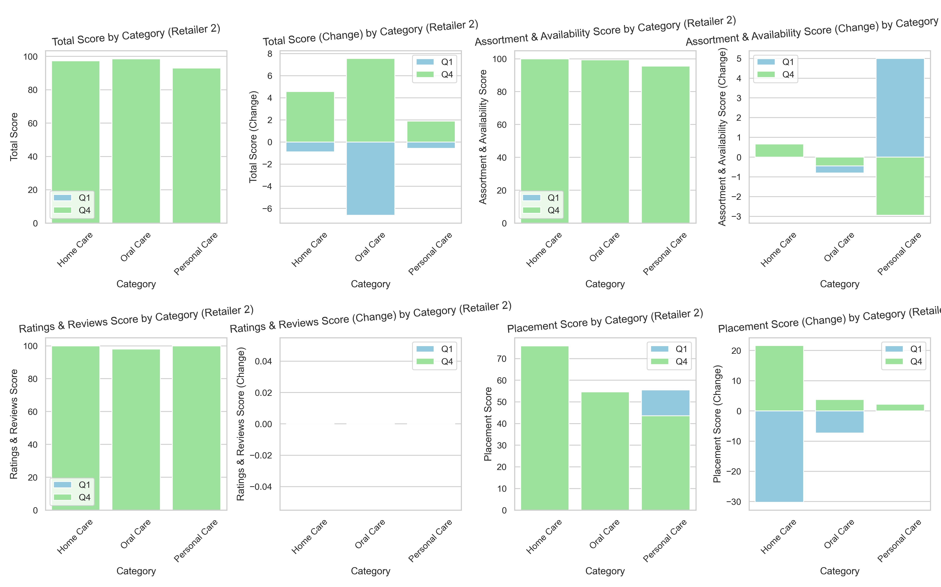
Other Metrics Analysis Retailer 2 :
Across most metrics for Retailer 2 in Q1, we see little to no improvement, except for a positive change in the Personal Care category's Placement score
The overall pattern across these metrics suggests that Retailer 2's performance in Q1 remained stagnant or declined in most areas.
While most metrics showed no improvement, it's encouraging to see positive changes in both Assortment & Availability and Placement scores for the Personal Care category in Q1.

Slide 9
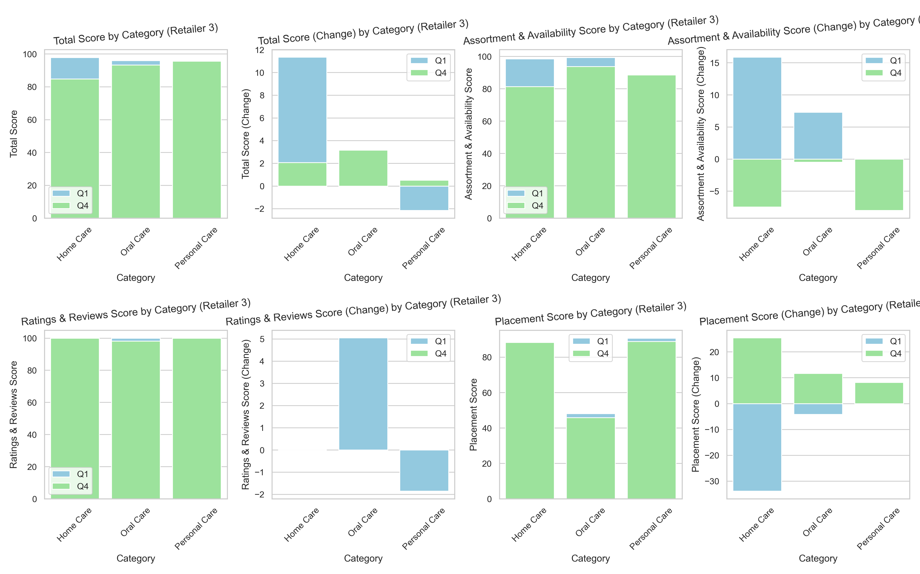
Other Metrics Analysis Retailer 3 :
Retailer 3 exhibits positive changes across most metrics, indicating improved performance and strategic planning compared to Q1.
Content scores also show a generally positive trend, further reinforcing strong performance in Q1.
The Home Care category stands out with particularly significant improvements in Total Score and Assortment & Availability, suggesting targeted efforts in these areas.

Slide 10
Conclusions:
Key Findings:
We discovered that Retailer 2's content scores have been on a decline over time, while Retailer 3's scores are on the rise. Overall, Retailer 3 seems to be performing better than Retailer 2.
Implications:
This highlights how crucial it is for Colgate to keep an eye on their digital shelf performance. Understanding these differences between retailers can help tailor strategies effectively.
Recommendations:
We suggest Colgate focus on areas where Retailer 2 is lagging behind. By refining their digital shelf strategy and prioritizing key initiatives, they can gain a competitive edge in the market.

